Slide 1
Spark Cont

Slide 2
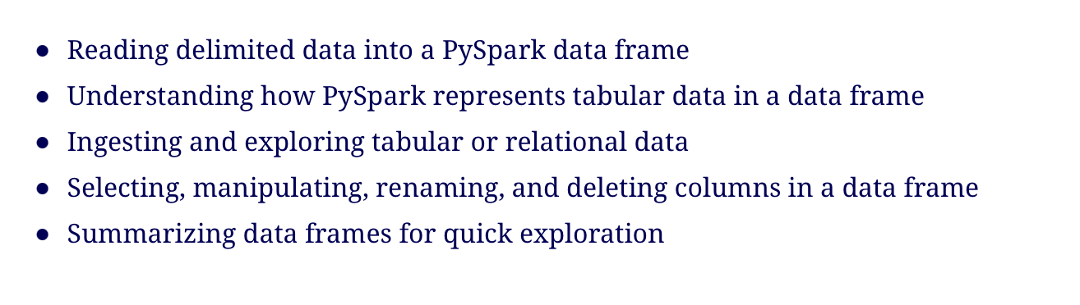
Notes:
goes deeper into data transformation, this time using structured data.
relational (or tabular,1 or row and columns) data, one of the most common formats popularized by SQL and Excel.
use the public Canadian television schedule data to identify and measure the proportion of commercials over its total programming.
how the data frame provides the necessary abstractions to represent a data table

Slide 3
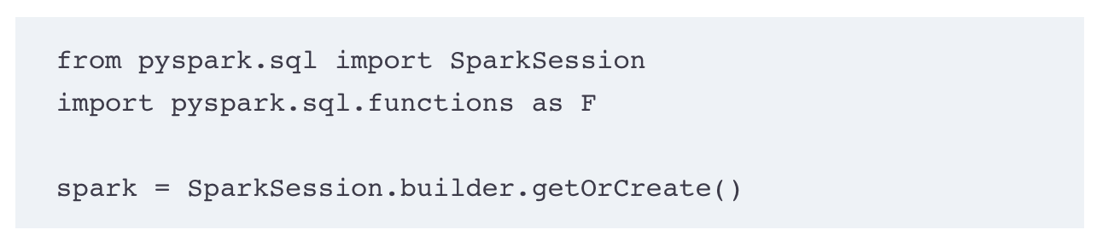
Create a spark session
Notes:
SparkReader object - this time for delimited data rather than unstructured text
most common operations on Column objects, processing data in a two-dimensional setting.
PySpark’s lightweight EDA (exploratory data analysis) capabilities through the summary() and describe() methods.

Slide 4
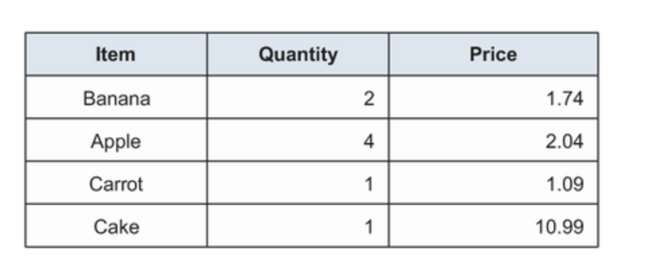
Tabular data
data tabular when we represent it in a two-dimensional table
cells, each containing a single (or simple) value, organized into rows and columns.
E.g., grocery list
Notes:
- easiest analogy we can make for tabular data is the spreadsheet format:
- Tabular data is an extremely common data format, and because it’s so popular and easy to reason about - PySpark’s data manipulation API.

Slide 5
PySpark data frame
PySpark’s data frame structure maps very naturally to tabular data.
PySpark operates either on the whole data frame structure (via methods such as select() and groupby()) or on Column objects (e.g., when using a function like split()).
The data frame is column-major, so its API focuses on manipulating the columns to transform the data
RDD : row-major
think about columns, you are thinking about items (rows) with attributes in which you apply functions.
PySpark has multiple ways to import tabular data, but the two most popular are the list of lists and the Pandas data frame.

Slide 6
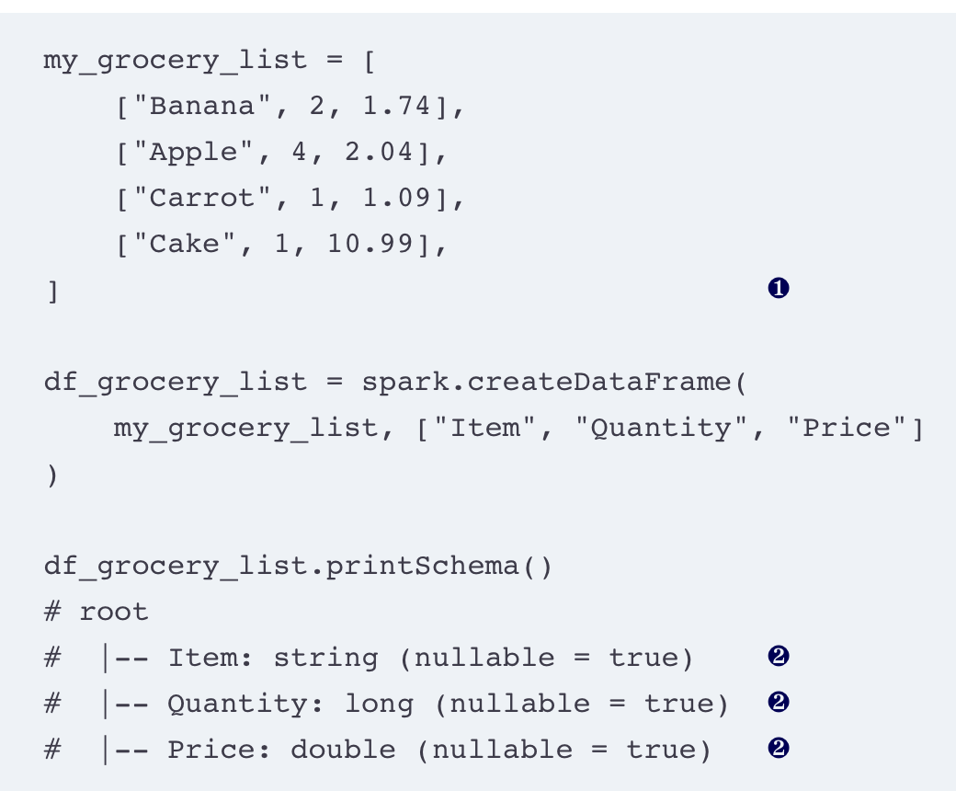
Notes:
My grocery list is encoded in a list of lists.
PySpark automatically inferred the type of each field from the information Python had about each value.
spark.createDataFrame() – create a data frame
- First parameter – data as list, pandas data frame or RDD
Second parameter– schema, a list of column name to incur the type
passing a list of column names will make PySpark happy while it infers the types (string, long, and double, respectively) of our columns.

Slide 7
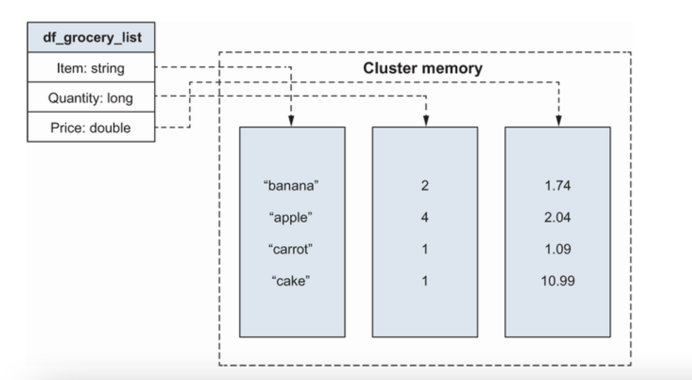
Notes:
The master node knows about the structure of the data frame,
actual data is represented on the worker nodes.
Each column maps to data stored somewhere on our cluster that is managed by PySpark.
- We operate on the abstract structure and let the master delegate the work efficiently.
- PySpark gladly represented our tabular data using our column definitions..
- the look and feel of a simple two-dimensional/tabular data frame. I

Slide 8
PySpark for analyzing and processing tabular data
Exploratory data analysis (EDA) For Large data set , explore and ask introductory questions
First step for data analysis
Graphical exploratory data analysis
PySpark doesn’t provide any charting capabilities like Matplotlib and plot.ly
Since data is distributed
toPandas() – to transform PySpark data frame to Pandas data frame, then use charting library.
Loose the advantage of working on multiple machines as data is saved on a drive
Notes:
Ingest and process a data frame
- Familiar with data discovery functions and methods, perform some basic data assembly
export the table in an easy-to-process format (e.g., to incorporate it in a report), you can use spark.write.csv, making sure you coalesce the data frame in a single file.
You do not want to move your data between a pandas and a PySpark data frame all the time. Reserve toPandas() for either discrete operations or for moving your data into a pandas data frame once and for all.
Moving back and forth will yield a ton of unnecessary work in distributing and collecting the data for nothing.
If you need pandas functionality on a Spark data frame, check out pandas UDFs (User defined function)

Slide 9
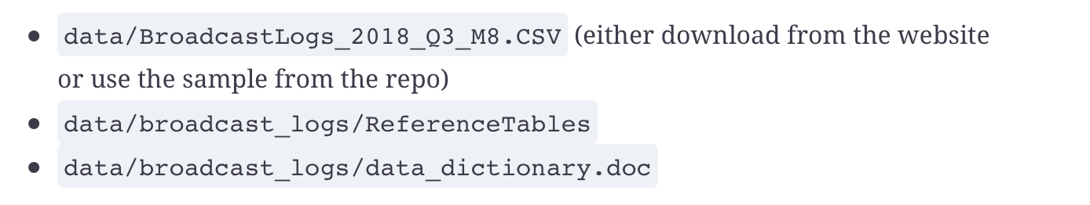
Example dataset
Canadian Radio-Television and Telecommunications Commission
Canada Open data portal: Download from http://mng.bz/y4YJ
Notes:
Canada Open Data portal (http://mng.bz/y4YJ); select the BroadcastLogs_2018_Q3_M8 file. The file is 994 MB to download,
repository contains a sample of the data under the data/broadcast_logs directoryl .
the Data Dictionary in .doc form,
Unzip the files in data/ broadcast_logs.
, the examples assume that the data is downloaded under data/broadcast_logs and that PySpark is launched from the root of the repository.
Spark can read directly from SQL database

Slide 10
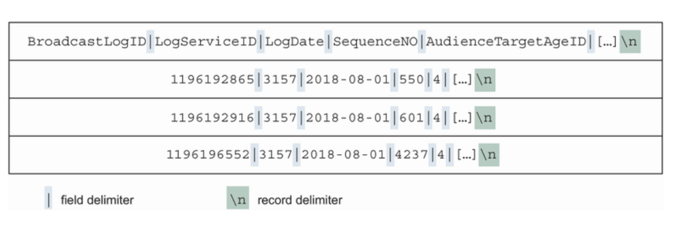
Reading and assessing delimited data in PySpark
Read the data before exploration and transformation
Row delimiter and column delimiter
Notes:
Delimited data is a very common, popular way to share data.
The first one is a row delimiter. The row delimiter splits the file into logical records. There is one and only one record between delimiters.
The second one is a field delimiter. Each record is made up of an identical number of fields, and the field delimiter tells where one field starts and ends.
PySpark provides 25 optional parameters when ingesting a CSV file.

Slide 11
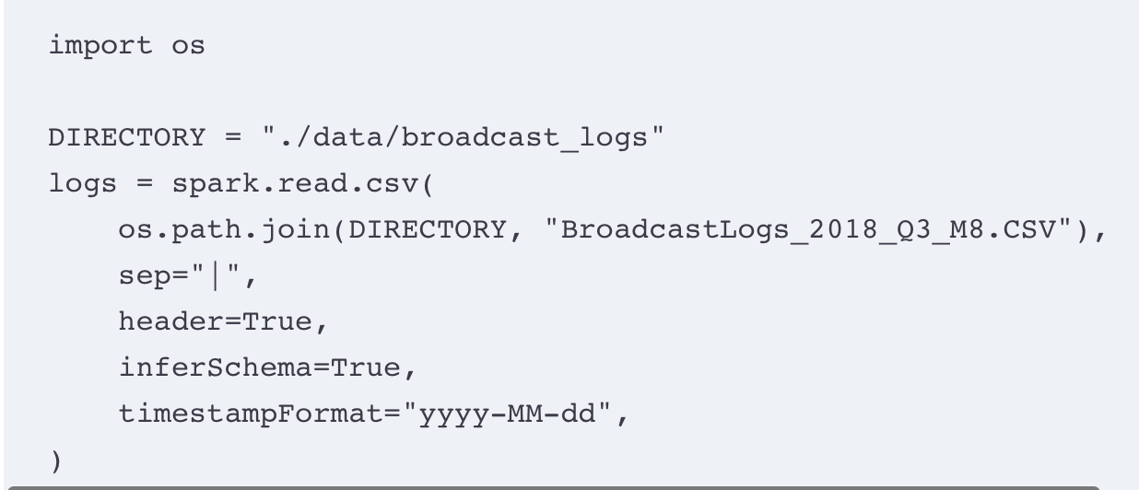
Reading broadcast information
Notes:
Spark to infer the data types with inferSchema
❶ We specify the file path where our data resides first.
❷ Our file uses a vertical bar as delimiter/separator, so we pass | as a parameter to sep.
❸ header takes a Boolean. When true, the first row of your file is parsed as the column names.
❹ inferSchema takes a Boolean as well. When true, it’ll pre-parse the data to infer the type of the column.
❺ timestampFormat is used to inform the parser of the format (year, month, day, hour, minutes, seconds, microseconds) of the timestamp fields

Slide 12
parameters
The path to the file you want to read as the only mandatory parameter
path, which contains the file or files’ path.
Use a glob pattern to read multiple files inside a directory, as long as they have the same structure
Can pass an explicit list of files
Passing an explicit field delimiter with the SEP parameter
Comma - most popular separator
Quoting text to avoid mistaking a character for a delimiter
The CSV reader object provides an optional quote parameter that defaults to the double-quote character (")

Slide 13
Using the first row as the column names
The header optional parameter takes a Boolean flag. If set to true, it’ll use the first row of your file
Inferring column type while reading the data
Optional parameter inferSchema to True (by default, this is turned off).
makes the ingestion quite a bit longer but helps us avoid writing the schema by hand
Notes:
- inferring the schema can be very expensive if you have a lot of data.
- read a data source multiple times, it’s a good idea to keep the schema information once inferred!
- also take a small representative data set to infer the schema, followed by reading the large data set.

Slide 14
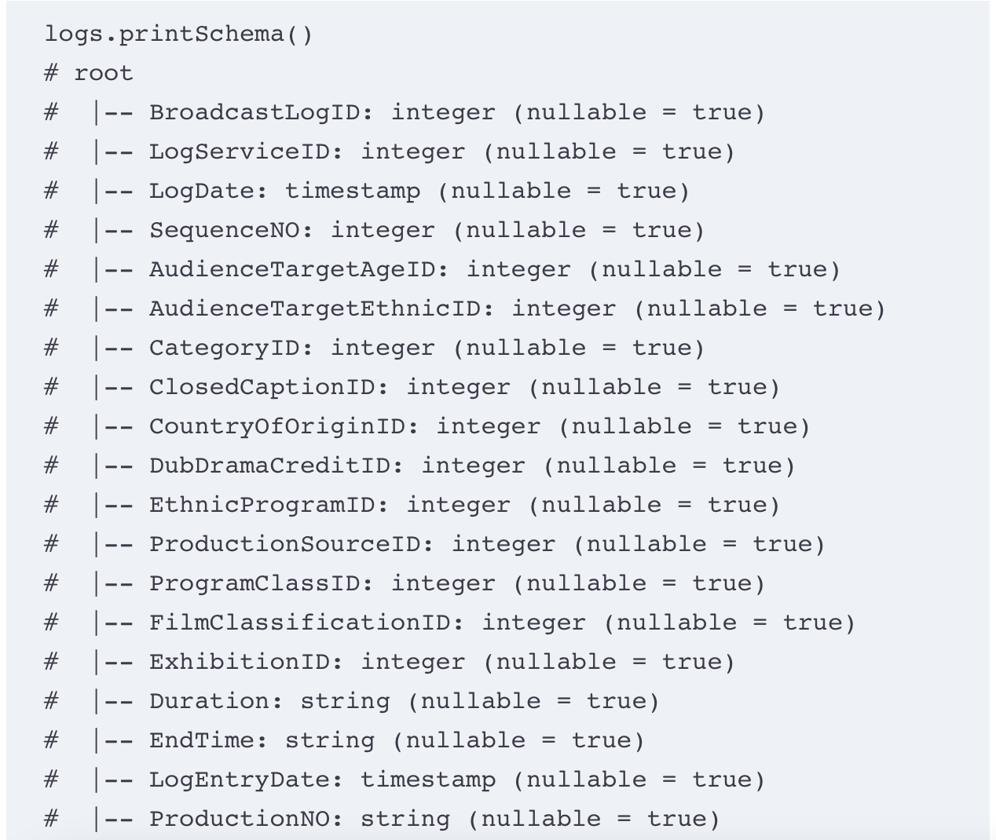
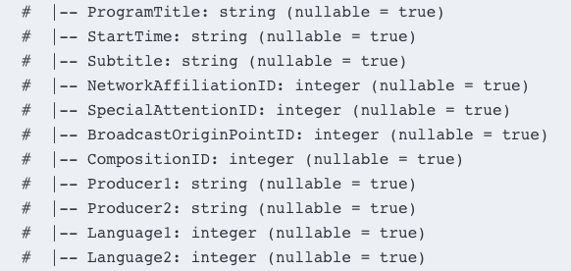
Notes:
Schema of the logs data frame

Slide 15
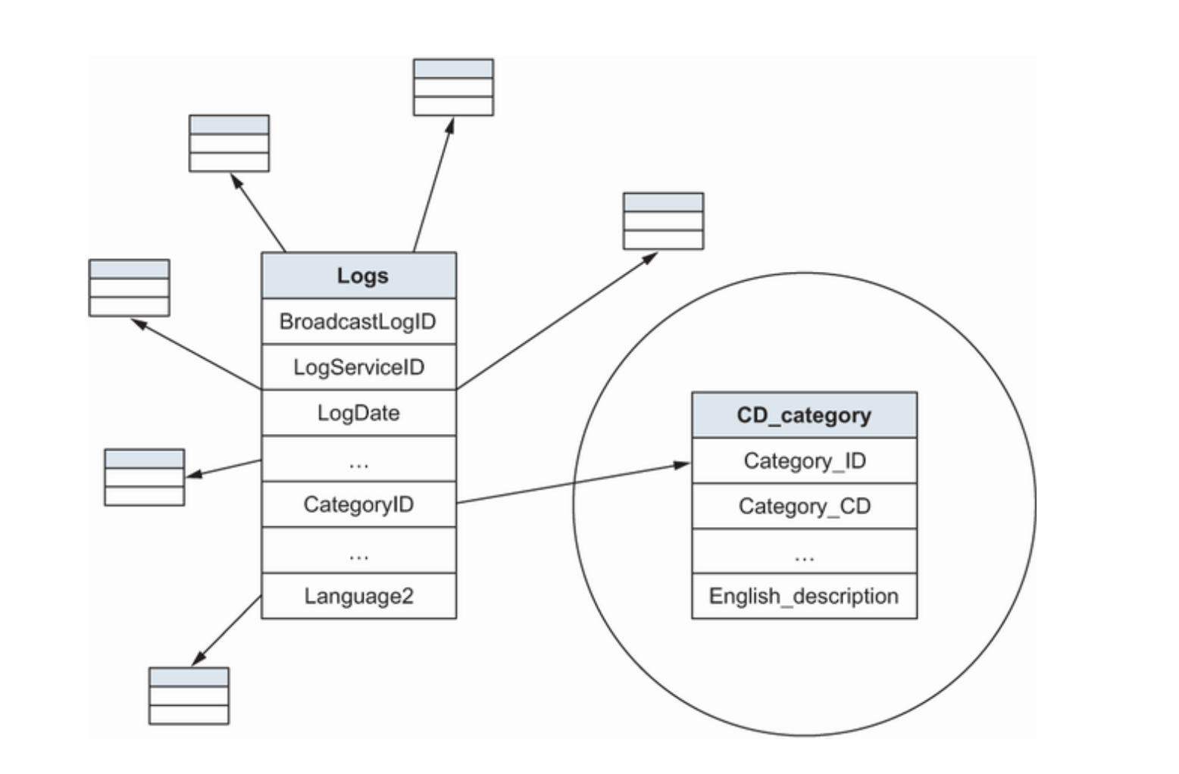
Exploring the shape of your data
Star schema
Notes:
a center table containing a bunch of IDs (or keys) and some ancillary tables containing a legend between each key and its value.
This is called a star schema since it looks like a star.
Star schemas are common in the relational database world because of normalization, a process used to avoid duplicating pieces of data and improve data integrity.
center table logs contain IDs that map to the auxiliary tables called link tables.

Slide 16
Spark prefers working with a single table
Denormalized tables (or fat table) – Spark prefers working with a single table instead of linking a multitude of tables to get the data.
looking at the logs table, its content, and the data documentation
avoid linking tables that contain data with no real value for our analysis.
Data warehouses don’t change their structure very often.
Notes:
Normalized data has many advantages when you’re working with relational information (
easier to maintain, data normalization reduces the probability of getting anomalies or illogical records in the data.
disadvantage, large-scale data systems sometimes embrace denormalized tables to avoid costly join operations.

Slide 17
Basic data manipulation
Select
Drop
rename
Order
diagnose

Slide 18
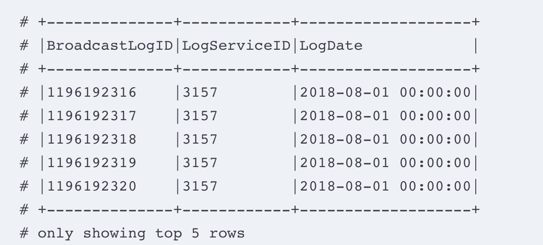
Select columns
Show() command to display a few records for exploration
Select() – select columns you want to keep in your data frame.
logs.select("BroadcastLogID", "LogServiceID", "LogDate").show(5, False)
Notes:
.show(5, False) shows five rows without truncating their representation so that we can show the whole content.
Select() can take >=1 column objects, or strings representing column names, and return a data frame containing only the listed columns.

Slide 19
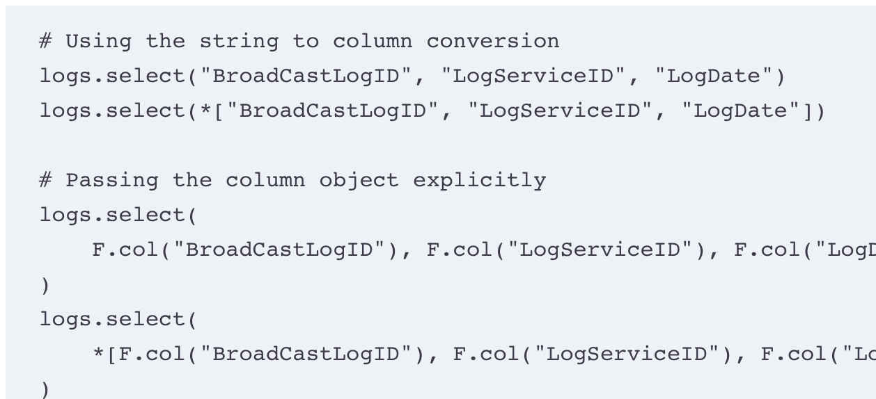
Column selector
Notes:
The 4 statements are interpreted the same.
prefixing the list with * removed the container so that each element becomes a parameter of the function
When explicitly selecting a few columns, you don’t have to wrap them into a list.
If you’re already working on a list of columns, you can unpack them with a * prefix.

Slide 20
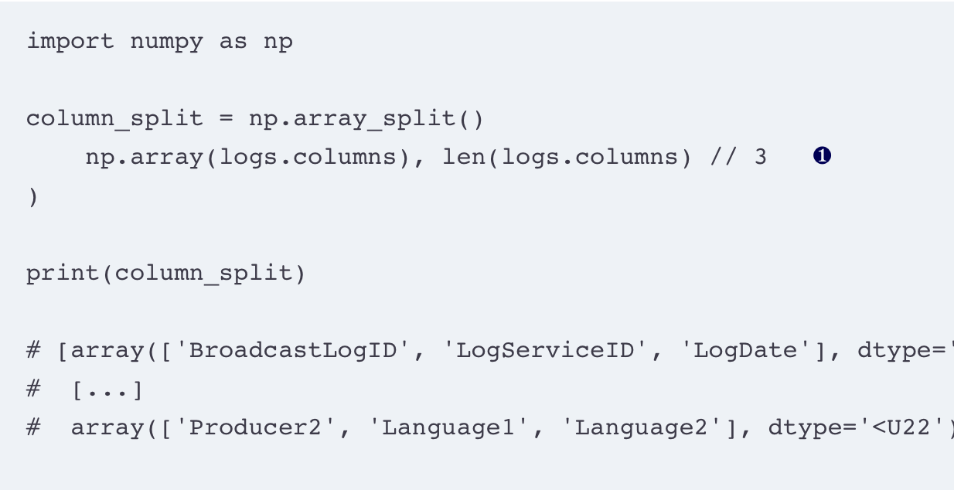
Peeking at the data frame in chunks of 3 columns
Notes:
A data frame keeps track of its columns in the columns attributes;
logs.columns is a Python list containing all the column names of the logs data frame.
❶ The array_split() function comes from the numpy package, imported as np at the beginning of this listing.
splitting the logs.columns list into approximate groups of three.
The function takes an array and a number of desired sub-arrays, N, and returns a list of N sub-arrays.
For the number of sub-arrays, we divide the number of columns by three, using an integer division, //.

Slide 21
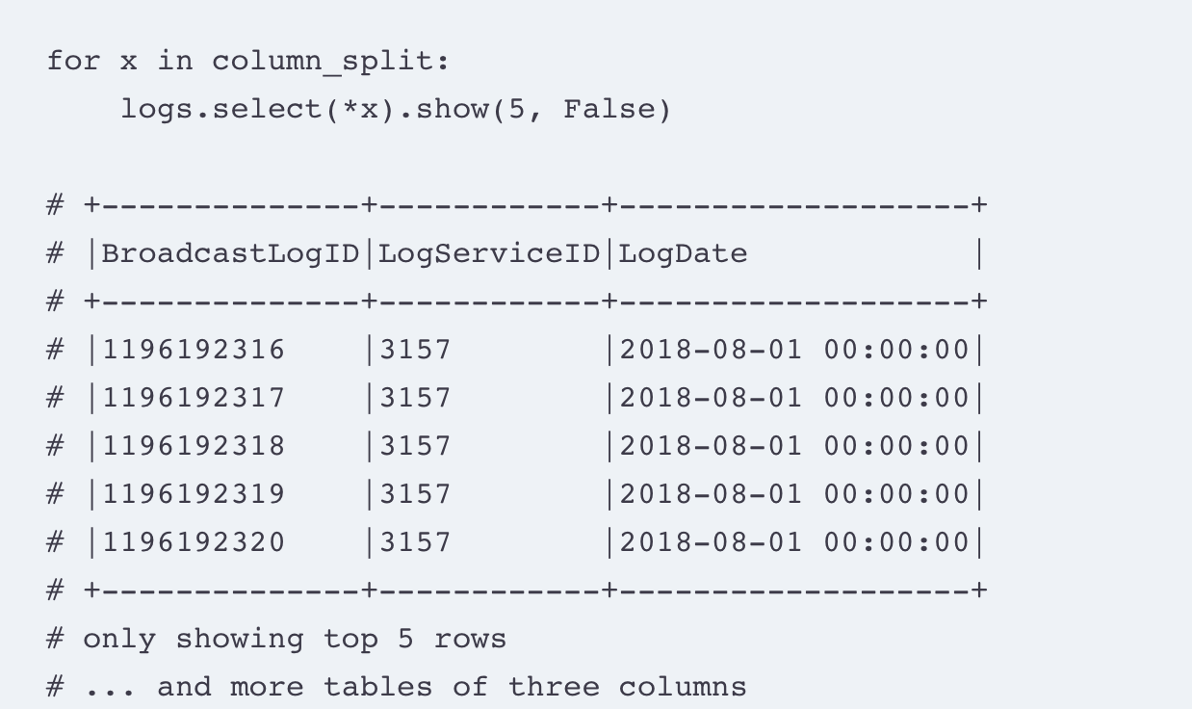
Notes:
iterates over the list of sub-arrays, using select();
select the columns present inside each sub-array and use show() to display them on the screen.

Slide 22
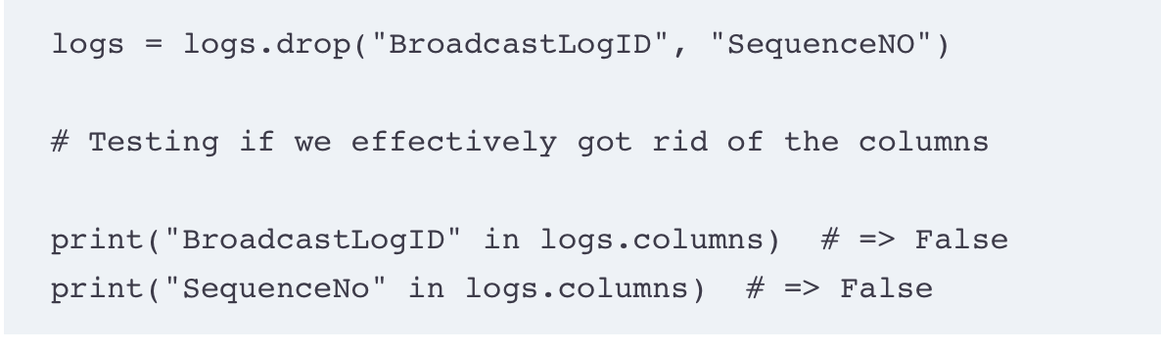
Keeping what we need, deleting columns
Drop the following columns
BroadCastLogID is the primary key of the table and will not serve us in answering our questions.
SequenceNo is a sequence number and won’t be useful either.
Notes:
selecting columns is choosing what not to select.
We could do the full trip with select(), carefully crafting our list of columns to keep just the one we want
Get rid of 2 columns – BroadcastLogID, SequenceNO
Just like select(), drop() takes a *cols and returns a data frame, this time excluding the columns passed as parameters.
Just like every other method in PySpark, drop() returns a new data frame, so we overwrite our logs variable by assigning the result of our code.
Unlike select(), where selecting a column that doesn’t exist will return a runtime error, dropping a nonexistent column is a no-op. PySpark will simply ignore the columns it doesn’t find.

Slide 23
Getting rid of columns, select style
logs = logs.select( *[x for x in logs.columns if x not in ["BroadcastLogID", "SequenceNO"]] )
Notes:
We can view drop() and select() as being two sides of the same coin: one drops what you specify; the other keeps what you specify

Slide 24
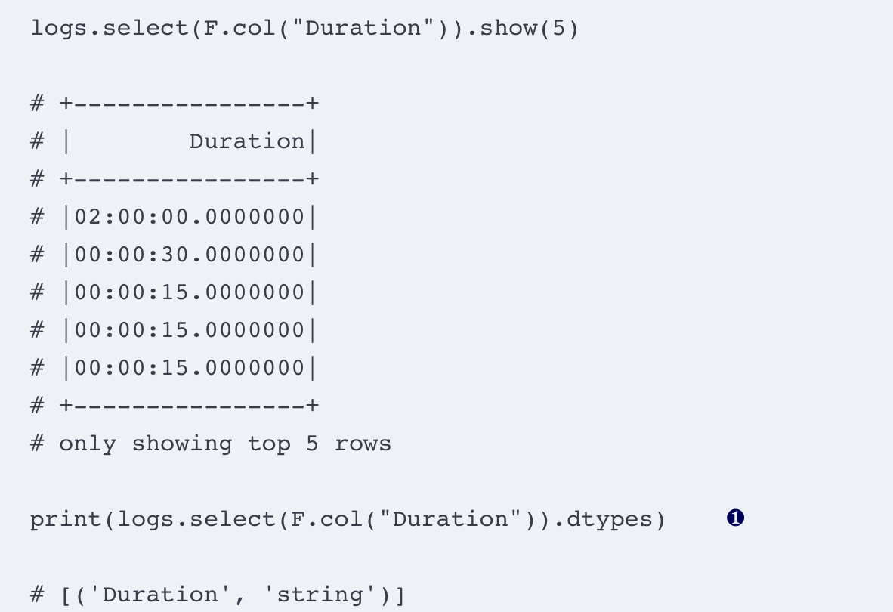
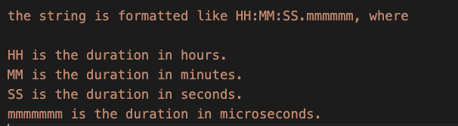
Create new columns
withColumn()
Notes:
Display the duration column – duration of each show.
PySpark doesn’t have a default type for time without dates or duration, so it kept the column as a string.
❶ The dtypes attribute of a data frame contains the name of the column and its type, wrapped in a tuple.
PySpark doesn’t have a default type for time without dates or duration, so it kept the column as a string

Slide 25
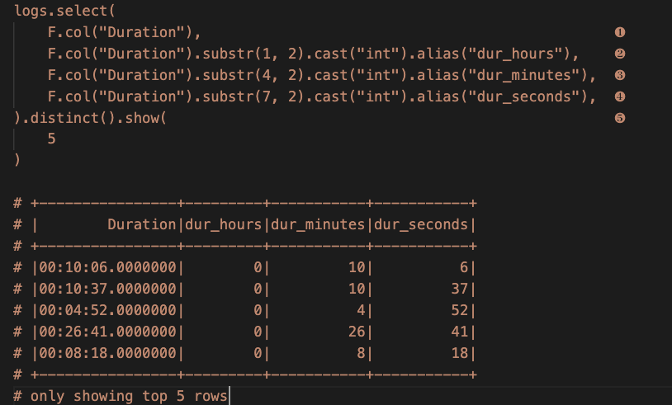
Notes:
- The pyspark.sql.functions module (which we aliased as F) contains the substr() function that extracts a substring from a string column
use it to extract the hours, minutes, and seconds from the Duration columns. The substr() method takes two parameters. The first gives the position of where the sub-string starts, the first character being 1, not 0 like in Python. The second gives the length of the sub-string we want to extract in a number of characters.
❶ The original column, for sanity
❷ The first two characters are the hours.
❸ The fourth and fifth characters are the minutes.
❹ The seventh and eighth characters are the seconds.
❺ To avoid seeing identical rows, I’ve added a distinct() to the results.
use the distinct() method before show(), which de-dupes the data frame.
distinct() to avoid seeing identical occurrences that would provide no additional information when displayed.

Slide 26
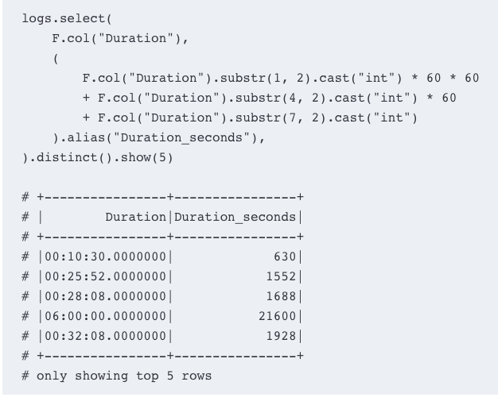
Create a duration in second field from the duration column
Notes:
performed arithmetic directly on the columns. There are 60 seconds in a minute, and 60 * 60 seconds in an hour.
PySpark respects operator precedence, so we don’t have to clobber our equation with parentheses.

Slide 27
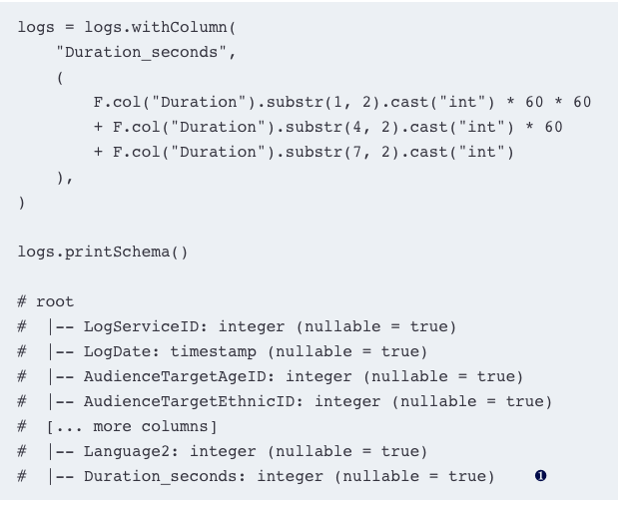
Add a column at the end of our data frame
Notes:
Instead of using select() on all the columns plus our new one, use withColumn()
Applied to a data frame, it’ll return a data frame with the new column appended.
Our Duration_seconds columns have been added at the end of our data frame.

Slide 28
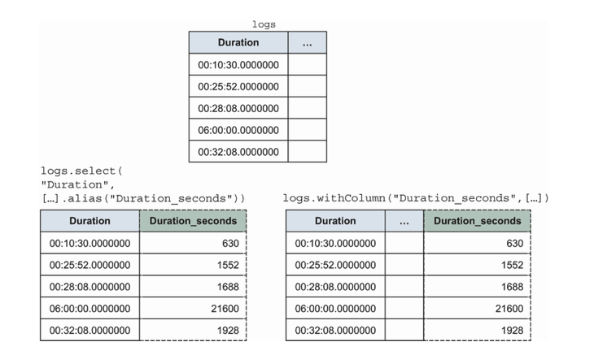
select() versus withColumn(), visually. withColumn() keeps all the preexisting columns without the need the specify them explicitly.
Notes:
When you need to create a few new ones without changing the rest of the data frame, I prefer withColumn().
Creating many (100+) new columns using withColumns() will slow Spark down to a grind. If you need to create a lot of columns at once, use the select() approach. While it will generate the same work, it is less tasking on the query planner.

Slide 29
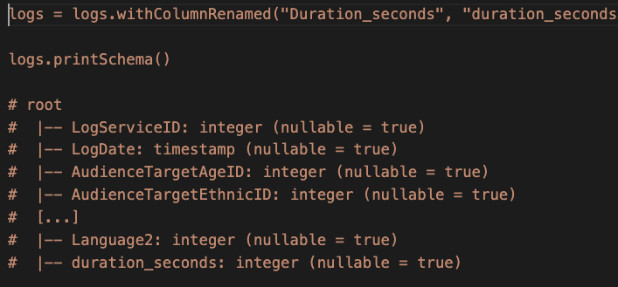
Rename a column

Slide 30
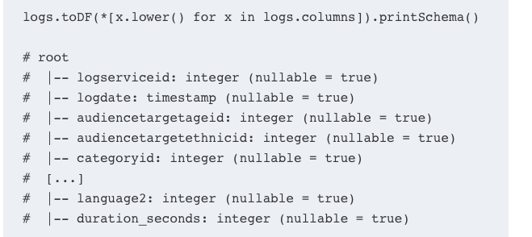
Batching lowercasing using toDF()
Notes:
we need to unpack our column names if they’re in a list

Slide 31
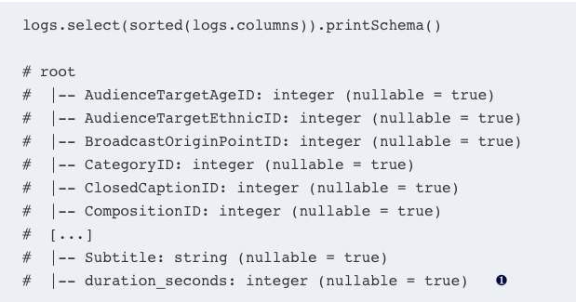
Re-ordering columns
Notes:
reordering columns is equivalent to selecting columns in a different order, select() is the perfect method
For instance, if we wanted to sort the columns alphabetically, we could use the sorted function on the list of our data frame columns,
in most programming languages, capital letters come before lowercase ones.

Slide 32
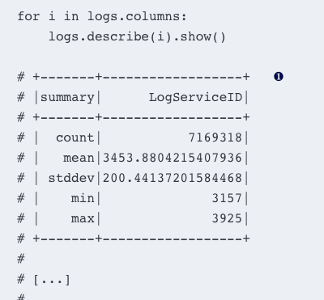
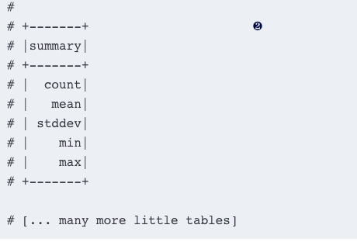
Diagnose a data frame with describe() and summary()
Notes:
how we can quickly explore numerical columns using PySpark’s describe() and summary() methods.
describe() will show summary statistics (count, mean, standard deviation, min, and max) on all numerical and string columns.
Note that describe() will (lazily) compute the data frame but won’t display it, just like any transformation, so we have to show() the result.
❶ Numerical columns will display the information in a description table, like so.
❷ If the type of the column isn’t compatible, PySpark displays only the title column.

Slide 33
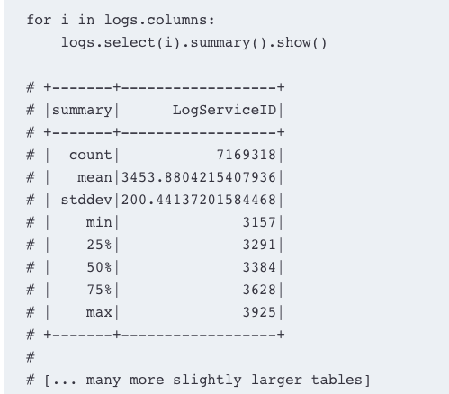
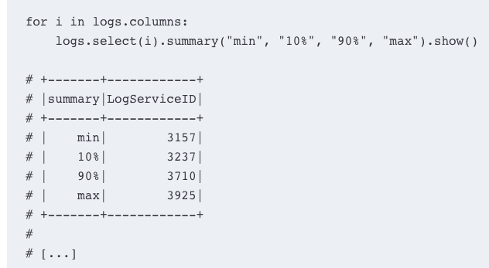
Summary()
Notes:
describe() will take *cols as a parameter (one or more columns, the same way as select() or drop()),
summary() will take *statistics as a parameter.
This means that you’ll need to select the columns you want to see before passing the summary() method.
❶ By default, we have count, mean, stddev, min, 25%, 50%, 75%, max as statistics.
❷ We can also pass our own, following the same nomenclature convention.

Slide 34
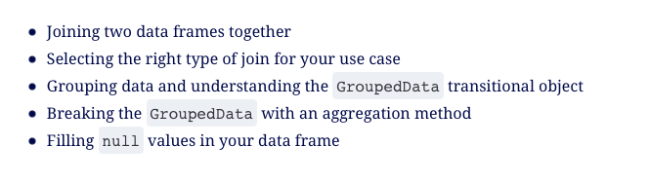
Notes:
Linking/joining data frame
Grouping data

Slide 35
Joining data – from many to one
need to link two sources
Joining data frames is a common operation when working with related tables
there are multiple ways to perform joins
merge or link

Slide 36
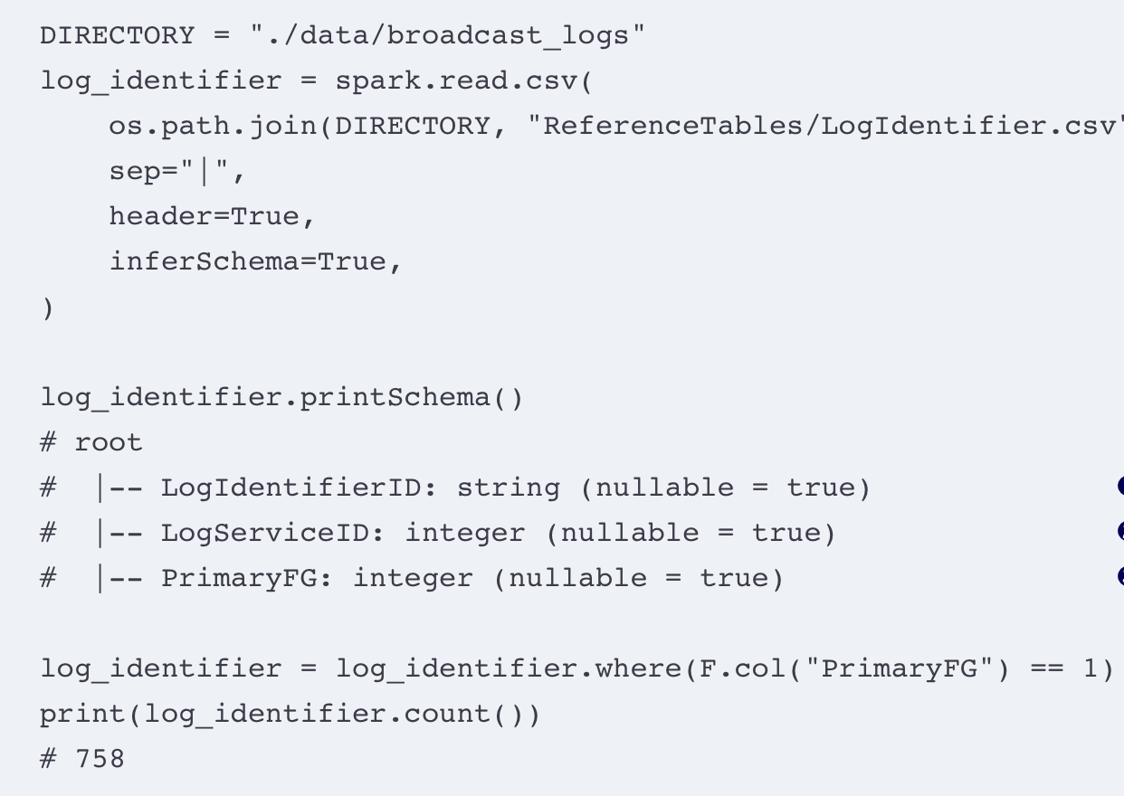
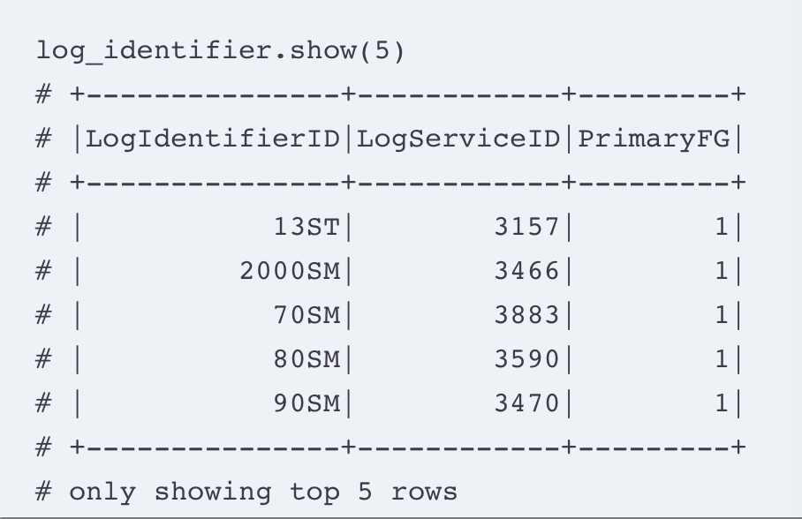
join operation is a way to take the data from one data frame and link it to another one according to a set of rules.
Notes:
join operation is a way to take the data from one data frame and link it to another one according to a set of rules.
Goal - filter the data frame to keep only the primary channels
❶ This is the channel identifier.
❷ This is the channel key (which maps to our center table).
❸ This is a Boolean flag: Is the channel primary (1) or (0)? We want only the 1s.

Slide 37
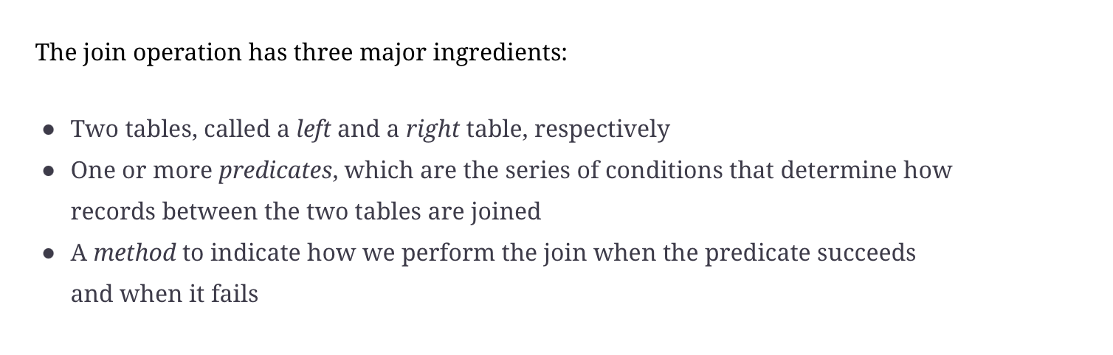
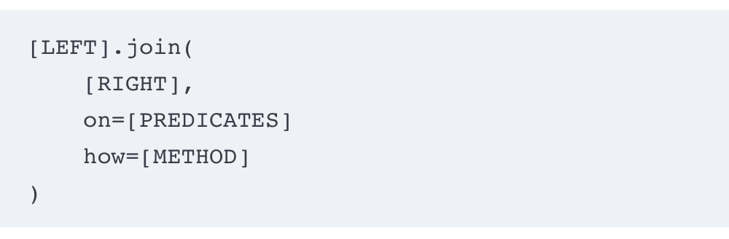
Blueprint for join
Notes:
construct a join between two data frames in PySpark by filling the blueprint

Slide 38
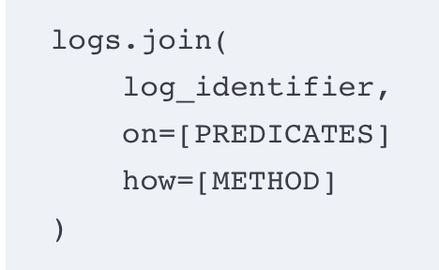
Notes:
Log is the left table, right is log_identifier
A join is performed on two tables at a time
In PySpark, the left table is to the left of the join() method, whereas the right is to the right (inside the parentheses).

Slide 39
The predicates
cornerstone of determining what records from the left table will match the right table.
Predicates - rules between columns of the left and right data frames.
A join is performed record-wise, where each record on the left data frame is compared (via the predicates) to each record on the right data frame
The predicates return True, the join is a match and is a no-match if False
you match the values from one table to the other, and the (Boolean) result of the predicate block determines if it’s a match.
Notes:
Most predicates in join operations are simple, but they can grow significantly in complexity depending on the logic you want

Slide 40
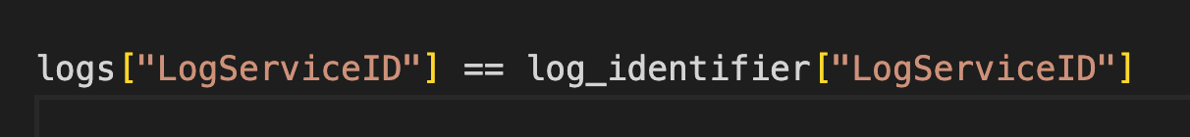
“match the records from the logs data frame to the records from the log_identifier data frame when the value of their LogServiceID column is equal.”
Notes:
- if one record in the left table resolves the predicate with more than one record in the right table (or vice versa), this record will be duplicated in the joined table.
- If one record in the left or right table does not resolve the predicate with any record in the other table, it will not be present in the resulting table unless the join method (see section 5.1.4) specifies a protocol for failed predicates.

Slide 41
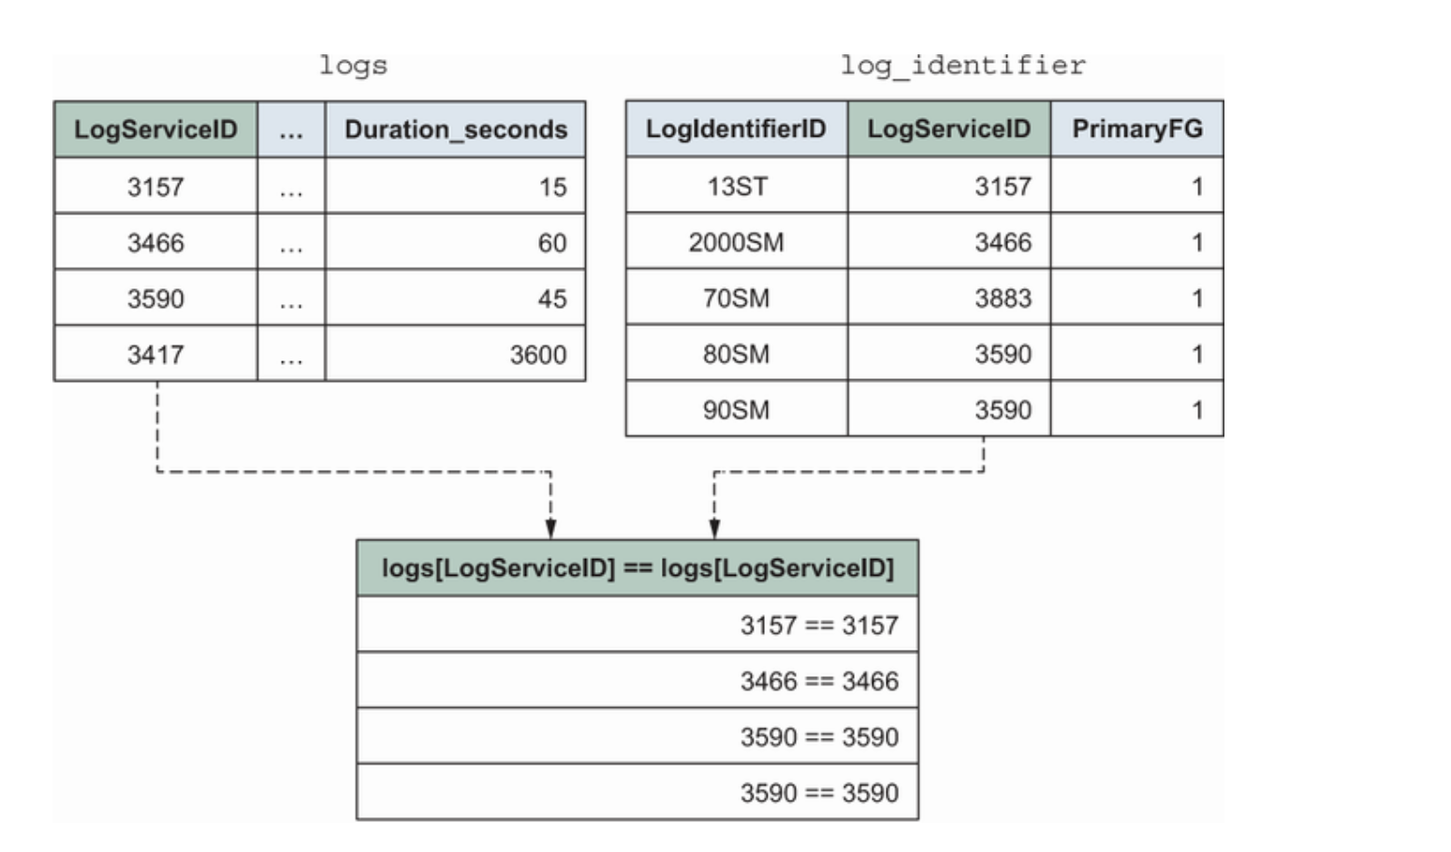
A simple join predicate resolution between logs and log_identifier using LogServiceID in both tables and equality testing in the predicate. I show only the four successes in the result table. Our predicate is applied to a sample of our two tables: 3590 in the left table resolves the predicate twice, while 3417 on the left and 3883 on the right have no matches.
Notes:
3590 record on the left is equal to the two corresponding records on the right, and we see two solved predicates with this number in our result set.
On the other hand, the 3417 record does not match anything on the right, and therefore is not present in the result set. The same thing happens with the 3883 record in the right table.

Slide 42
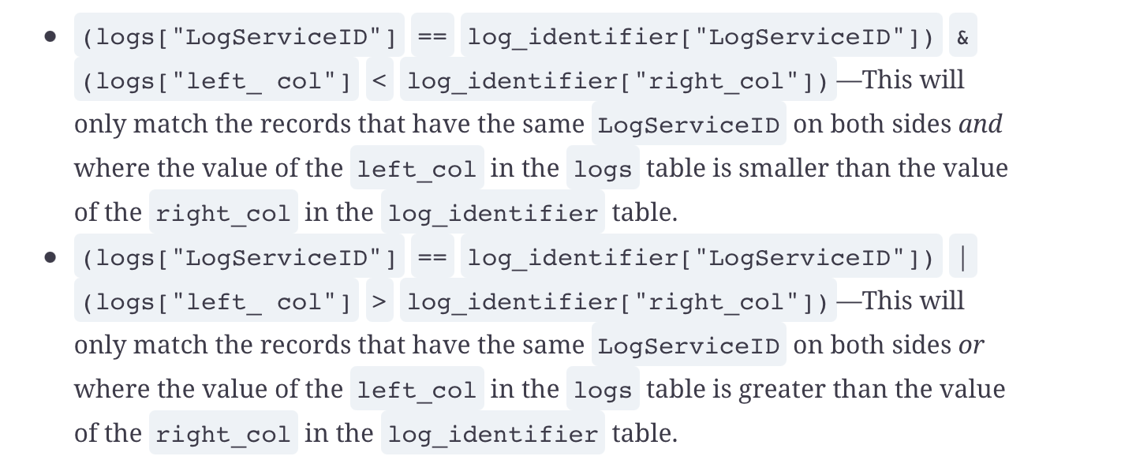
Multiple conditions in predicate

Slide 43
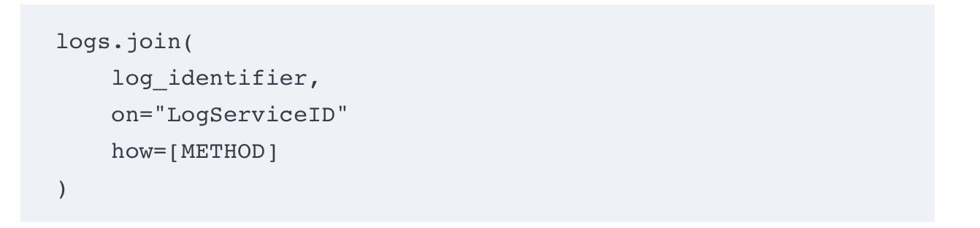
A join in PySpark, with left and right table and predicate
Notes:
performing an “equi-join,” where you are testing for equality between identically named columns,
you can simply specify the name of the columns as a string or a list of strings as a predicate.
In our case, it means that our predicate can only be "LogServiceID"

Slide 44
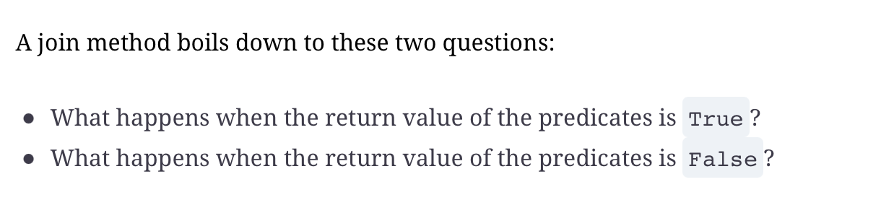
How …

Slide 45
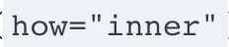
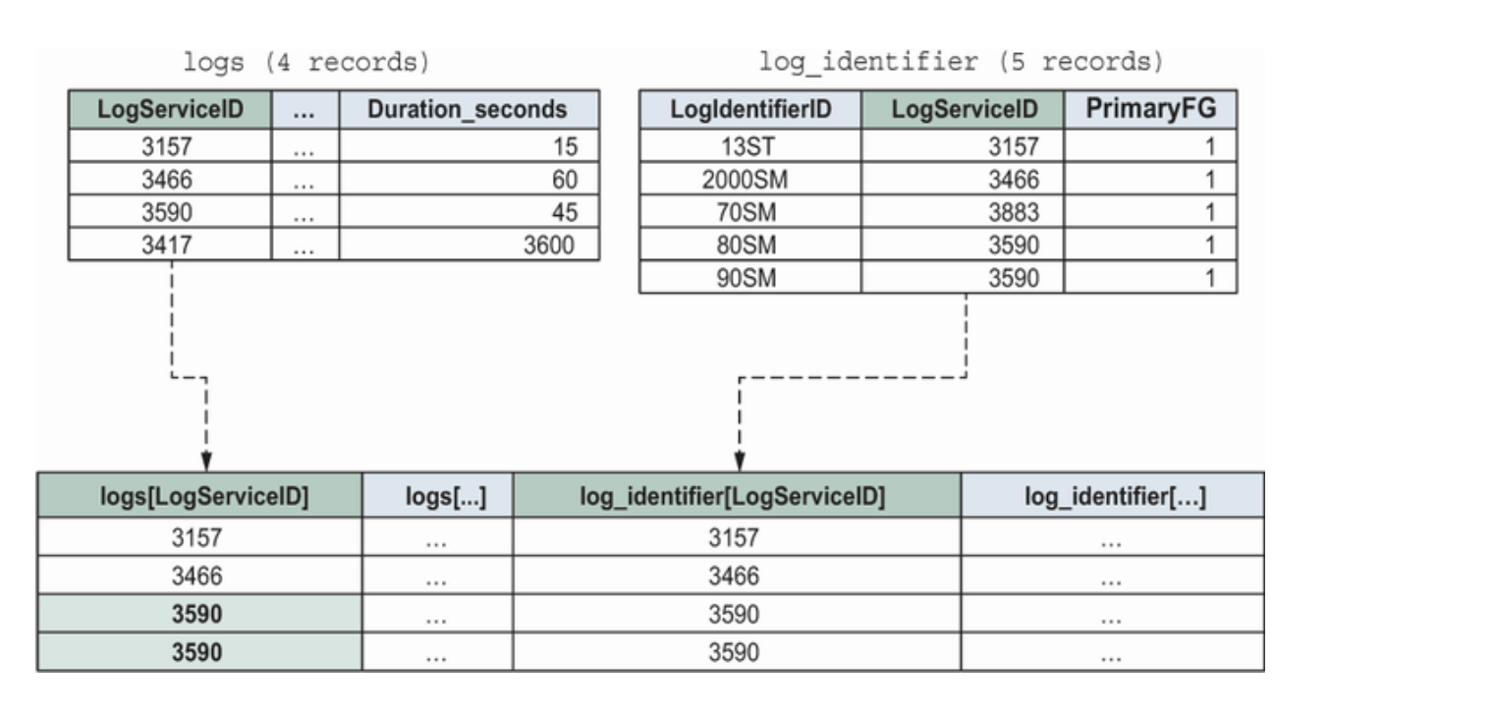
Inner join
Default join method
It returns a record if the predicate is true and drops it if false.
Notes:
An inner join. Each successful predicate creates a joined record.
. The record with the LogServiceID == 3590 on the left will be duplicated because it matches two records in the right table

Slide 46
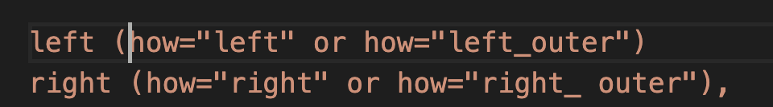
Left and right outer join
A left (also called a left outer) join will add the unmatched records from the left table in the joined table, filling the columns coming from the right table with null.
A right (also called a right outer) join will add the unmatched records from the right in the joined table, filling the columns coming from the left table with null.

Slide 47
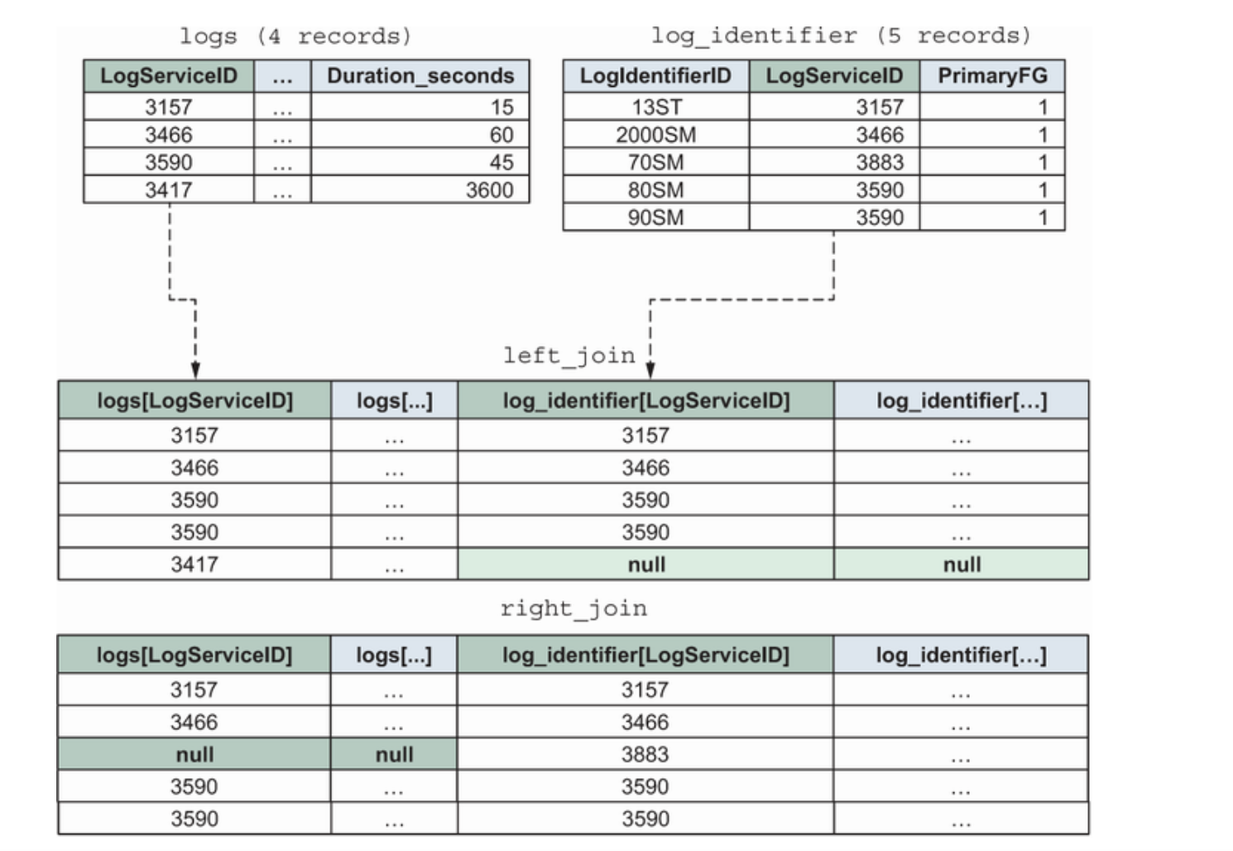
Notes:
- this means that your joined table is guaranteed to contain all the records of the table that feed the join (left or right).
- Left and right joins are very useful when you are not certain if the link table contains every key. You can then fill the null values (see listing 5.16) or process them knowing you didn’t drop any records.

Slide 48
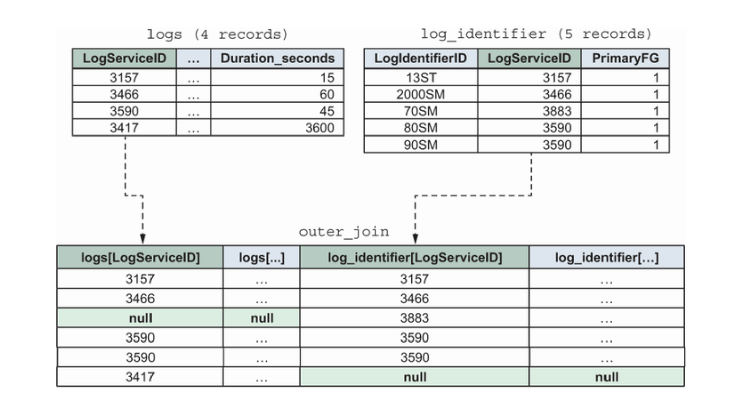
Full outer join
Notes:
simply the fusion of a left and right join. It will add the unmatched records from the left and the right table, padding with null. It serves a similar purpose to the left and right join but is not as popular since you’ll generally have one (and only one) anchor table where you want to preserve all records.

Slide 49
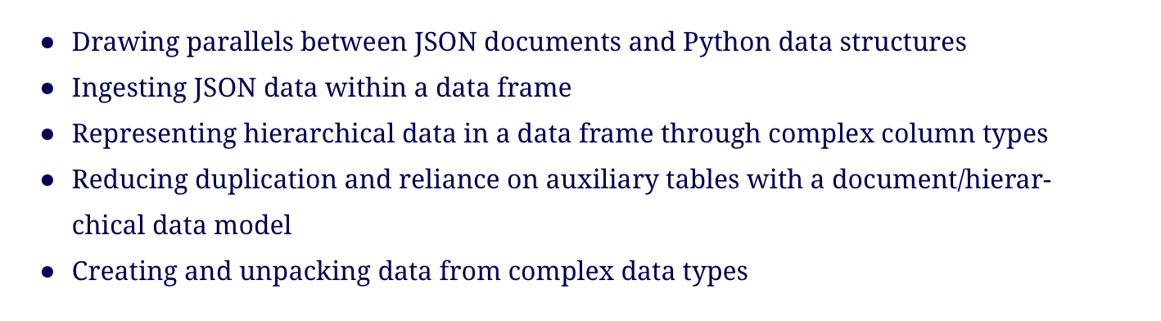
PySpark with JSON data

Slide 50
JSON
ingesting and working with hierarchical JSON data using the PySpark data frame.
JSON (JavaScript Object Notation) data rapidly took over as the dominant data format for exchanging information between a client (such as your browser) and a server.
In big data, JSON allows you to store more rich data types than plain scalar values compared to tabular serialization formats such as CSV.

Slide 51
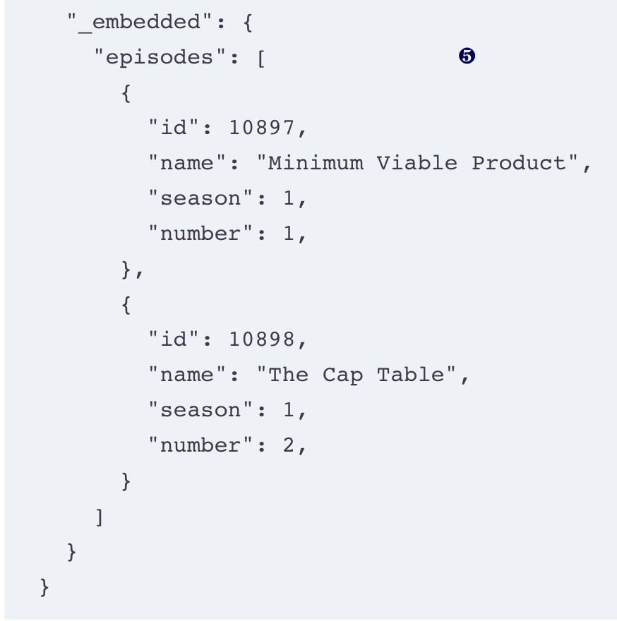
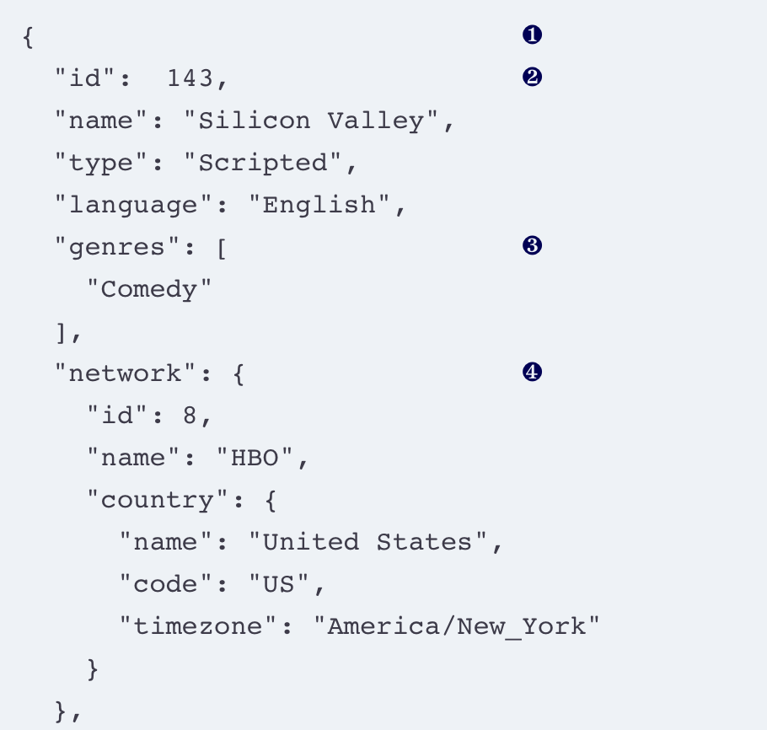
Reading JSON
Notes:
Download JSON data from the TV Maze API (available online: http://mng.bz/g4oR).
❶ At the top level, a JSON object looks like a Python dictionary. Both use the brackets to delimit object boundaries.
❷ JSON data is encoded into key-value pairs, just like in a dictionary. JSON keys must be strings.
❸ JSON arrays can contain multiple values (here, we have a single string).
❹ Objects can be values too; you can nest objects within one another this way.
❺ Our episodes are each objects contained within an array.
Looks like a Python dictionary

Slide 52
JSON data is a long-standing data interchange format
became massively popular for its readability and its relatively small size.
JSON stands for JavaScript Object Notation
Think of each JSON file can be thought of as a JavaScript object. The official JSON website (https://json.org)

Slide 53
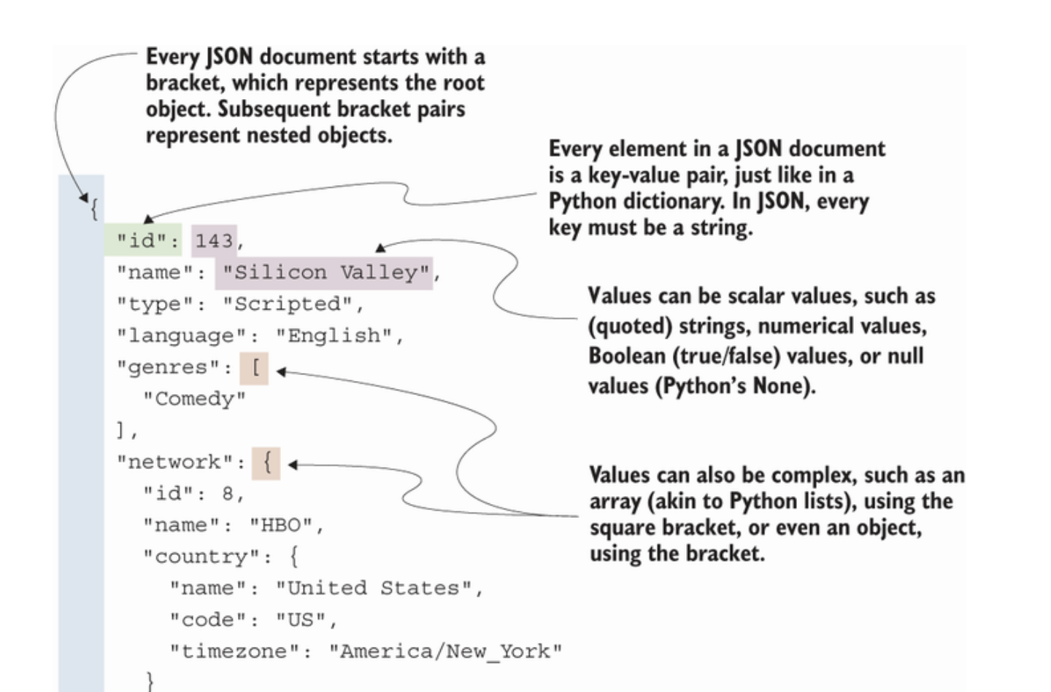
Notes:
A JSON object—or a Python dictionary—both have keys and values.
the keys of a JSON object must be a string.
Python dictionaries don’t have that limitation,

Slide 54
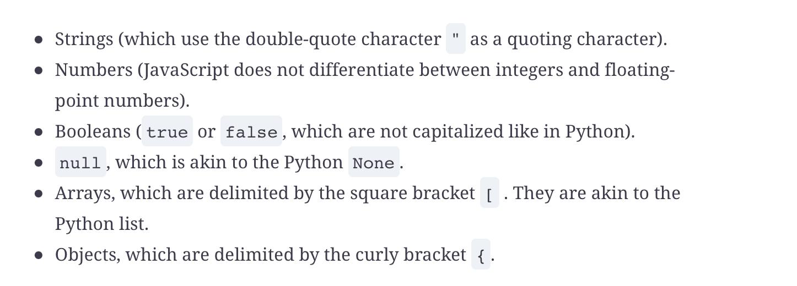
JSON data types

Slide 55


Reading JSON
Notes:
❶ import the json module, available in the Python standard library.
❷ Our loaded document looks like a Python dictionary with string keys. Python recognized that 143 was an integer and parsed the number as such.
❸ Our loaded document is of type dict.
how the JSON object can be thought of as a limited Python dictionary.
Keys are always strings, and values can take numerical, Boolean, string, or null values.
You can also have arrays of elements or objects as values, which enables nesting and hierarchical organization of the data.

Slide 56

Reading JSON data in PySpark
Notes:
- The specialized SparkReader object is accessible by calling the json method on spark.read, just like with CSV or text data.
- The document ingested contains only a single record.
Unlike CSV data, JSON data doesn’t need to worry about record delimiters or inferring data types (JSON forces the usage of string delimiters, so the value 03843 is a number, where "03843" is a string),
In PySpark, reading JSON follows this rule: one JSON document, one line, one record. This means that if you want to have multiple JSON records in the same document, you need to have one document per line and no new line within your document.
JSON Lines document format (http://jsonlines.org/)

Slide 57

Read multiple documents
ingest multiple documents across multiple files
set the multiLine (careful about the capital L!) parameter to true.
This will change the JSON reading rule to the following: one JSON document, one file, one record.
you can use the glob pattern (using a * to refer to multiple files),
Notes:
two more shows available in the data/shows directory (Breaking Bad and The Golden Girls, to cover a wide gamut). I
read the three JSON documents and indeed have three records.

Slide 58
Breaking the second dimension with complex data types
PySpark’s ability to use complex types inside the data frame is what allows its remarkable flexibility.
Complex data types (container, or compound type)
data types that contain other types
Python: list, tuple, dictionary
Spark – array, map, struct

Slide 59



Notes:
❶ Like a JSON document, the top-level element of our data frame schema is called the root.
❷ A complex column introduces a new level of nesting in the data frame schema.

Slide 60

When you have more than one value: the array
JSON array ~= Python list
PySpark arrays are containers for values of the same type
Array[string] represents a column containing an array of strings
PySpark will not raise an error if you try to read an array-type column with multiple types. Instead, it will simply default to the lowest common denominator, usually the string. This way, you don’t lose any data, but you will get a surprise later if your code expects an array of another type.
Notes:
PySpark container type – array
PySpark arrays are container for values of the same type.
The genres array points to an element item, which is of type string

Slide 61


Select the name and genres columns
Notes:
The genres column is of type Array[string], meaning that it contains any number of string values in a list-type container.

Slide 62

Extract items in array
PySpark provides a very pythonic way to work with arrays as if they were lists.
Arrays are zero-indexed when retrieving elements inside, just like Python lists. Unlike Python lists, passing an index that would go beyond the content of the list returns null.
Notes:
PySpark provides a very pythonic way to work with arrays as if they were lists
Arrays are zero-indexed when retrieving elements inside, just like Python lists. Unlike Python lists, passing an index that would go beyond the content of the list returns null
❶ Use the dot notation and the usual square bracket with the index inside.
❷ Instead of the index in square bracket syntax, we can use the getItem() method on the Column object.
Can’t use [] as a slicing tool. PySpark will accept only one integer as an index, so array_subset.genres[0:10] will fail and return an AnalysisException with a cryptic error message.

Slide 63
Prepare a data frame for SQL
Think of PySpark data frames as tables
Spark’s SQL API only covers the data manipulation subset of Spark.
Notes:
Spark provides a full SQL API that is documented in the same fashion as the PySpark API (http://mng.bz/vozJ).

Slide 64

Query a data frame SQL style
Notes:
- PySpark doesn’t make the link between the python variable elements, which points to the data frame, and a potential table elements that can be queried by Spark SQL.
To allow a data frame to be queried via SQL, we need to register it.
When we assign a data frame to a variable, Python points to the data frame. Spark SQL does not have visibility over the variables Python assigns.

Slide 65
RDD

Slide 66
Extend PySpark with Python: Resilient Distributed Dataset
Using RDD as lower-level flexible data container
Manipulate data in RDD using higher level functions

Slide 67
Resilient Distributed Dataset (RDD)
RDD is similar to the data frame but distributes unordered objects rather than records and columns.
object-first approach provides more flexibility compared to the more rigid schema of the data frame.

Slide 68
PySpark data frame vs RDD
While the data frame is becoming more and more flexible as the Spark versions are released, the RDD still reigns in terms of flexibility.
The RDD especially shines in two use cases:
When you have an unordered collection of Python objects that can be pickled (which is how Python calls object serialization)
When you have unordered key, value pairs, like in a Python dictionary
Notes:
Python object serialization: see http://mng.bz/M2X7)

Slide 69

RDD
The collection_rdd. Each object is independent from the others in the container—no column, no structure, no schema.

Slide 70
Unlike the data frame, where most of our data manipulation tool kit revolved around columns, RDD revolves around objects
think of an RDD as a bag of elements with no order or relationship to one another. Each element is independent of the other.

Slide 71

Create a RDD from Python list
Notes:
- create a list containing multiple objects of different types, and then promote it to an RDD via the parallelize method
The creation of the RDD takes the objects on the list, serializes (or pickles) them, and then distributes them between the worker nodes.
❶ My collection is a list of an integer, a string, a float, a tuple, and a dict
❷ The RDD functions and methods are under the SparkContext object, accessible as an attribute of our SparkSession. I alias it to sc for convenience.
❸ The list gets promoted to an RDD using the parallelize method of the SparkContext.
❹ Our collection_rdd object is effectively an RDD. PySpark returns the type of the collection when we print the object.

Slide 72
Compared to a data frame, the RDD is much more freestyle in terms of what it accepts.
If we were trying to store an integer, a string, a floating-point number, a tuple, and a dictionary in a single column, the data frame would have (and fail) to find a common denominator to fit those different types of data.

Slide 73
Manipulating data RDD way: map(), filter(), reduce()
Manipulating data with an RDD feels like giving orders to an army as a general:
you have full obedience from your privates/divisions in the field/cluster
if you give an incomplete or wrong order, you’ll cause havoc within your troops/RDD.
each division has its own specific type of order it can perform,
pySpark.RDD object: map(), filter(), reduce()
take a function (that we will call f) as their only parameter and return a copy of the RDD with the desired modifications.
We call functions that take other functions as parameters higher-order functions.

Slide 74

Apply one function to every object: map
PySpark provides map(). This directly echoes the functionality of the map() function in Python.
Notes:
apply a function that adds 1 to its argument in every object in the RDD.
After the application of the function, via map(), collect() each of the elements of the RDD in a Python list to print them back—

Slide 75

Notes:
To understand why our code is failing, we’ll break down the mapping process,
- apply the add_one() function to each element in the RDD by passing it as an argument to the map() method.
-add_one() is a regular Python function, applied to regular Python objects.
-Since we have incompatible types (e.g., "two" + 1 is not a legal operation in Python), three of our elements are TypeError.
- collect() the RDD to peek at the values, it explodes into a stack trace right in REPL.
The RDD is a lazy collection. If you have an error in your function application, it will not be visible until you perform an action (e.g., collect()), just like with the data frame.

Slide 76

Try block
Notes:
❶ recreate my RDD from scratch to remove the erroneous operation in the thunk (see chapter 1 for a description of a computation thunk).
❷ Our function returns the original value untouched if it encounters a TypeError.
❸ The relevant elements of the RDD have been incremented by 1.

Slide 77
you use map() to apply a function to every element of the RDD. Because of the flexibility of the RDD, PySpark does not give you any safeguards regarding the content of the RDD.
Developer is responsible for making your function robust regardless of the input.

Slide 78
Keep what you want with filter()
filter() is used to keep only the element that satisfies a predicate.
The RDD version of filter() is a little different than the data frame version:
it takes a function f, which applies to each object (or element) and keeps only those that return a truthful value.

Slide 79

Notes:
- filter my RDD to keep only the integer and float elements, using a lambda function.
- The isinstance() function returns True if the first argument’s type is present in the second argument; in our case, it’ll test if each element is either a float or an int.

Slide 80

Named function vs lambda
Notes:
Lambda functions are a great way to reduce boilerplate when you need a simple function for only one use.
a lambda function allows you to create a function without assigning it a name
correspondence between a named function (using the def keyword) and a lambda (or anonymous) function using the lambda keyword.
Both statements return a function object that can then be used: where the named function can be referred to by its name (is_a_number), the lambda function is usually defined where it needs to be used.
In the case of the filter() application, could have have replaced our lambda by the is_a_number function, but directly using a lambda function as the argument to filter() saves a few keystrokes.

Slide 81

.
Filtering our RDD to keep only int and float. Our predicate function is applied element-wise, and only the values leading to truthy predicates are kept.
Notes:
Just like map(), the function passed as a parameter to filter() is applied to every element in the RDD. This time, though, instead of returning the result in a new RDD, we keep the original value if the result of the function is truthy. If the result is falsy, we drop the element

Slide 82
TWO ELEMENTS COME IN, ONE COMES OUT: REDUCE()
enables the summarization of data (similar to groupby()/agg()) using the data frame. reduce(), is used to reduce elements in an RDD.
By reducing - taking two elements and applying a function that will return only one element. PySpark will apply the function to the first two elements, then apply it again to the result and the third element, and so on, until there are no elements left.

Slide 83

Notes:
MapReduce framework (https://research.google/pubs/pub62/)
This framework was a direct inspiration for big data frameworks, such as Hadoop and Spark. Although modern abstractions, such as the data frame, aren’t as close to the original MapReduce, the ideas remain, and gaining a high-level understanding of the building blocks will make it easier to understand some higher-level design choices.

Slide 84


Slide 85
Reduce() in a distributed world
Because of PySpark’s distributed nature, the data of an RDD can be distributed across multiple partitions.
The reduce() function will be applied independently on each partition, and then each intermediate value will be sent to the master node for the final reduction.
Because of this, you need to provide a commutative and associative function to reduce().

Slide 86

Commutative and associative functions

Slide 87
PySpark RDD API
covered how the RDD applies transformations to its elements through higher-order functions such as map(), filter(), and reduce().
Those higher-order functions apply the functions passed as parameters to each element, making the RDD element-major (or row-major).

